Slide 1
Explainable AI for Vision Transformers
Team:
Aarathi Vijayachandran
Evelyn Starzew
Supervisor:
Dr. Valerie Krug

Slide 2
Introduction & Motivation

Slide 3


Introduction
Neural networks are getting bigger and more complex → It is not exactly clear how a model solves its task
⇒ XAI is needed to gain insight into the inner workings of a DNN, gain trust, and improve reliability
Black Box
Golf Ball
Vaswani et al. introduced Transformer Architecture in 2017 → Application to Computer Vision by Dosovitskiy et al. in 2020: Vision Transformer ViT
→ Vision Transformer can perform equally well to CNNs → we focus on ViT

Slide 4
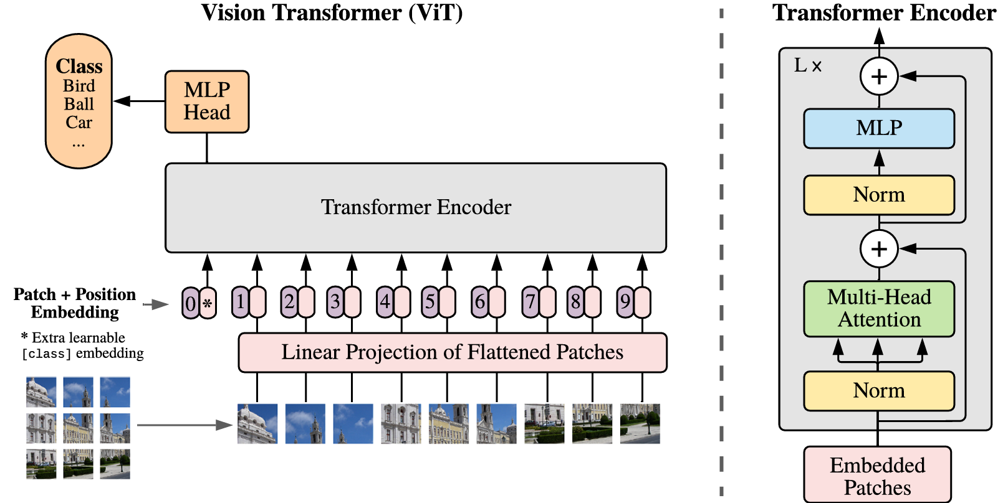
Vision Transformer (ViT)
Dosovitskiy et al. 2020

Slide 5
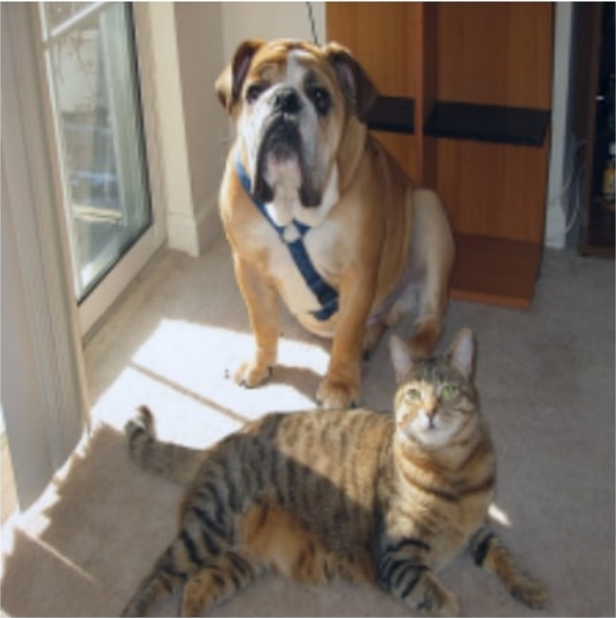
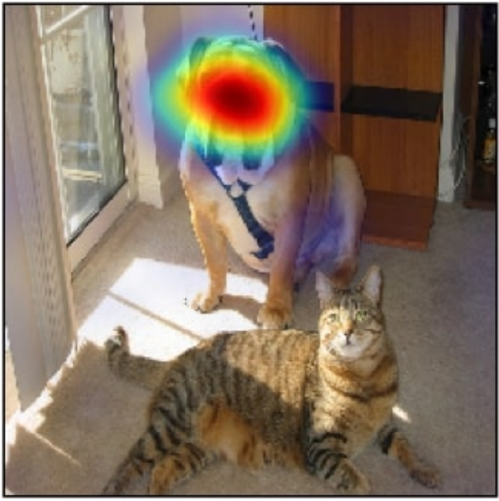
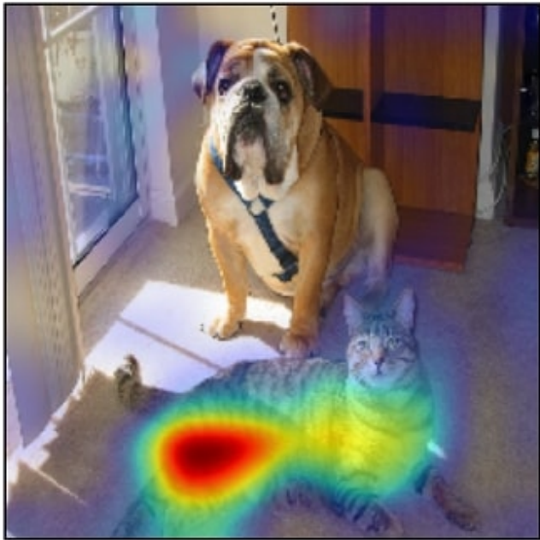
Motivation
XAI methods: local and global explanations (Dwivedi et al. 2023)
Local: analyze individual predictions & decisions
e.g. GradCAM (Selvaraju et al. 2020), LRP (Bach et al. 2015), Integrated Gradients (Sundararajan et al. 2016)
→ developed for CNNs → application to (Vision) Transformers is challenging
new methods explicitly for Transformers: e.g. Attention Rollout (Abnar & Zuidema 2020)
rolls out attention from last layer to capture propagation of information, while considering residual connections

Slide 6
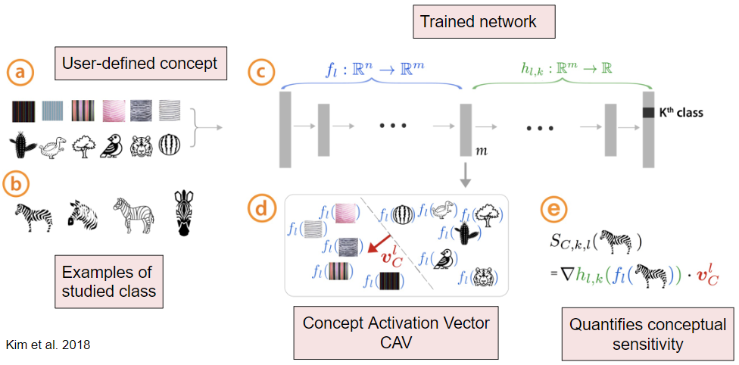
Motivation
XAI methods: local and global explanations (Dwivedi et al. 2023)
Global: overall analysis of the model and its general behavior
little research in representational analyses for ViTs
→ explore how ViTs process similar images / images of a concept
idea of analyzing the representation of concepts is not new:

Slide 7
Motivation
Goal:
Investigate how concepts are represented in a Vision Transformer and whether their similarities align with human intuition

Slide 8
Methodology

Slide 9
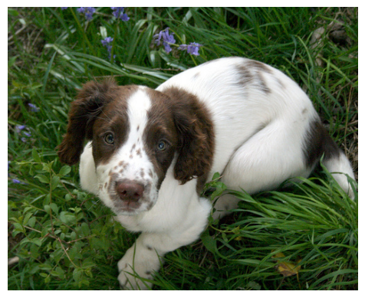
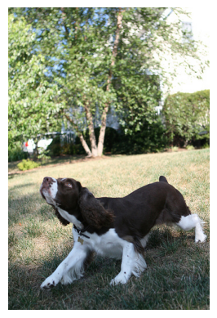
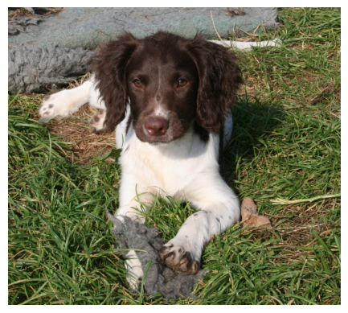
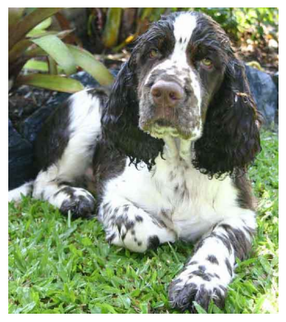
Dataset & Model Choice
Model: google/vit-base-patch16-224
Pre-trained on ImageNet-21k at a resolution of 224x224
Fine-tuned on ImageNet 2012 at a resolution of 224x224
Images: Sequence of fixed-size patches (resolution 16x16)
Number of layers: 12 transformer encoder layers
Hidden size/embedding vector size: 768 dimensions
Number of attention heads: 12
Dataset: frgfm/imagenette
smaller subset of 10 classes from ImageNet:
Tench fish, English Springer Spaniel dog, cassette player, chain saw,
church, French horn, garbage truck, gas pump, golf ball, parachute
each class has ~1300 images
for all experiments, the first 20 images of each class are used to form “concepts”
Class “Dog”

Slide 10
Concept Embedding
embed
average
average
14x14 = 196 Patches
196+1 (CLS) 768- Dimensional Embeddings
768-Dimensional Embeddings
Concept Embedding for Class “Dog”

Slide 11
Concept Embedding
Right now: Average over all patches
Should the concept embeddings of “dog” and “golf ball” be similar, just because they often share grass in the background?
⇒Idea: average only over “relevant” patches for a concept
But what does “relevant” mean…?

Slide 12
Concept Embedding
Find Relevant Patches to Represent Concepts
We want to find the most relevant patches of a concept to calculate the average embedding
Patch Relevance
Attention
Gradient
Embedding
CLS Attention
Attention Rollout
Aggregated Attention
Notes:
Attention relevance
raw attention values at specific layers of the CLS token - avg over heads
Attention Rollout values at specific layers of CLS token - avg over heads
aggregated attention values at a specific layer over all heads for each token (excluding CLS)
Gradient relevance
gradient of the logits with respect to a patch embedding at a specific layer (only positive contribution) - avg over 768 dimensions of a patch
Embedding relevance
768-dimensional embedding of a patch (excluding CLS) - max of 768 abs. values

Slide 13
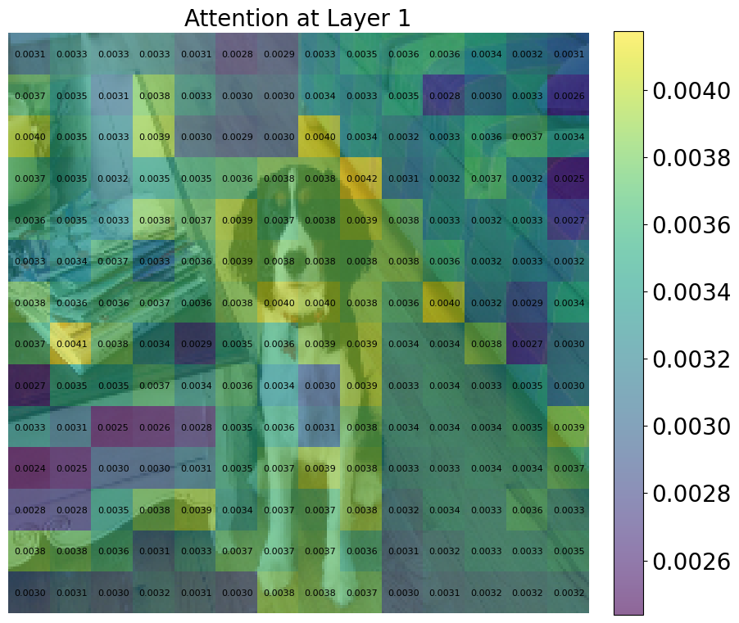
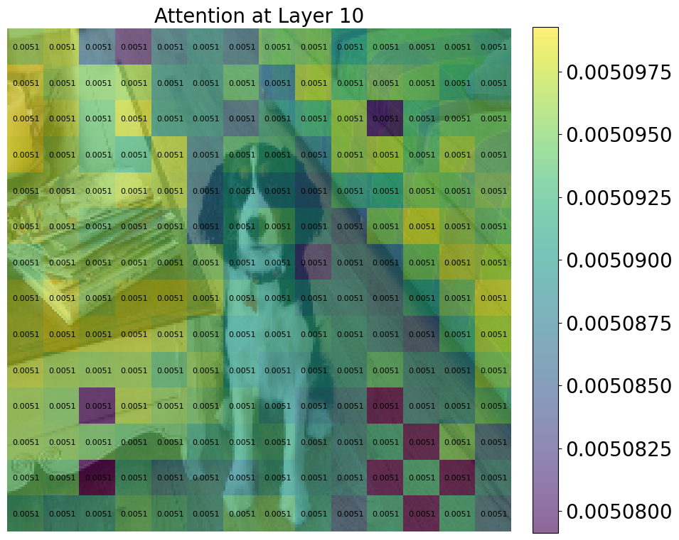
Concept Embedding
Attention Relevance - CLS Attention

Slide 14
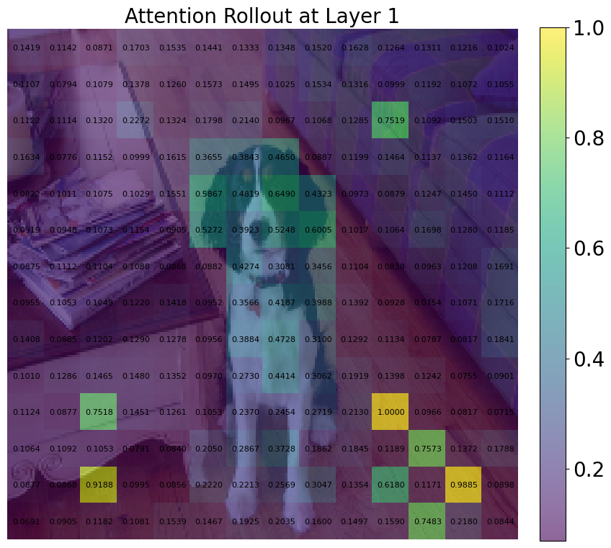
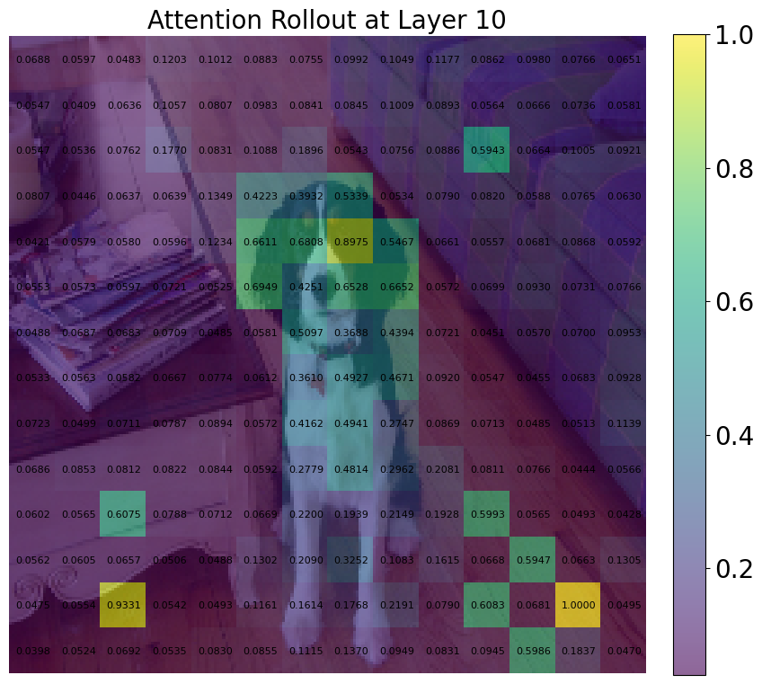
Concept Embedding
Attention Relevance - Attention Rollout (Abnar & Zuidema 2020)

Slide 15
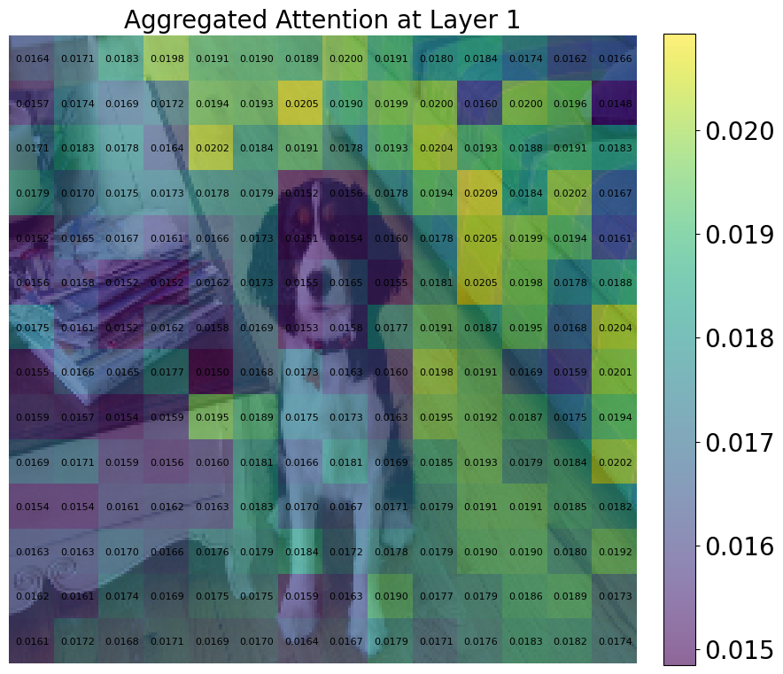
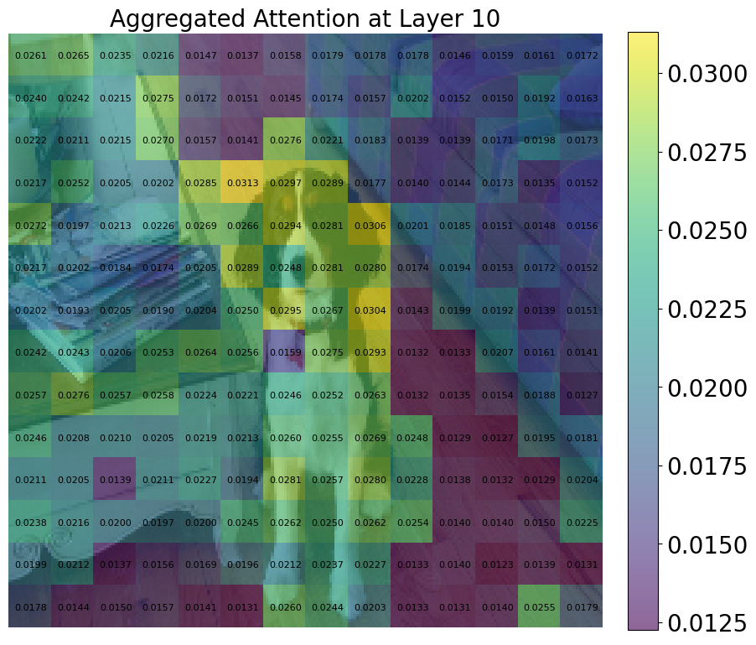
Concept Embedding
Attention Relevance - Aggregated Attention (layer-wise max. attention over all heads)

Slide 16
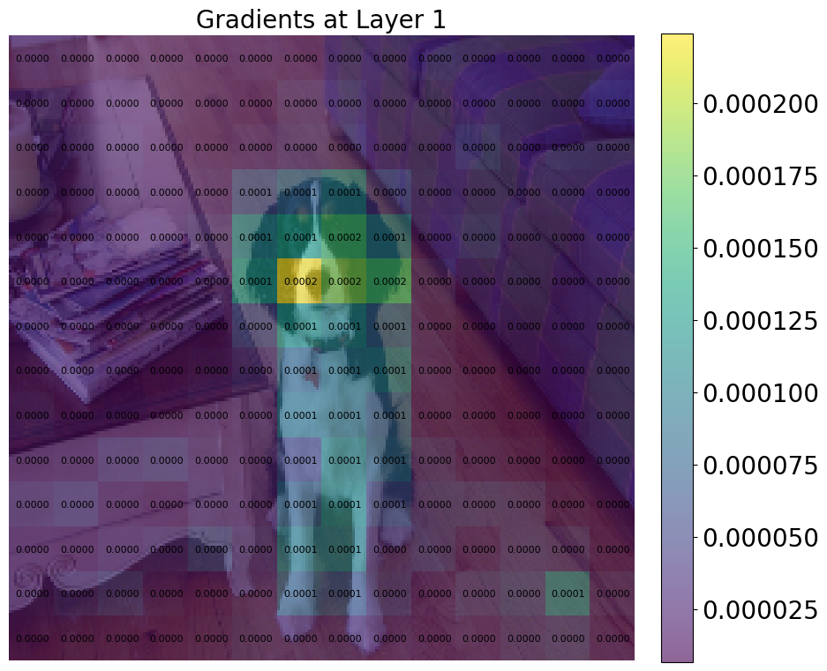
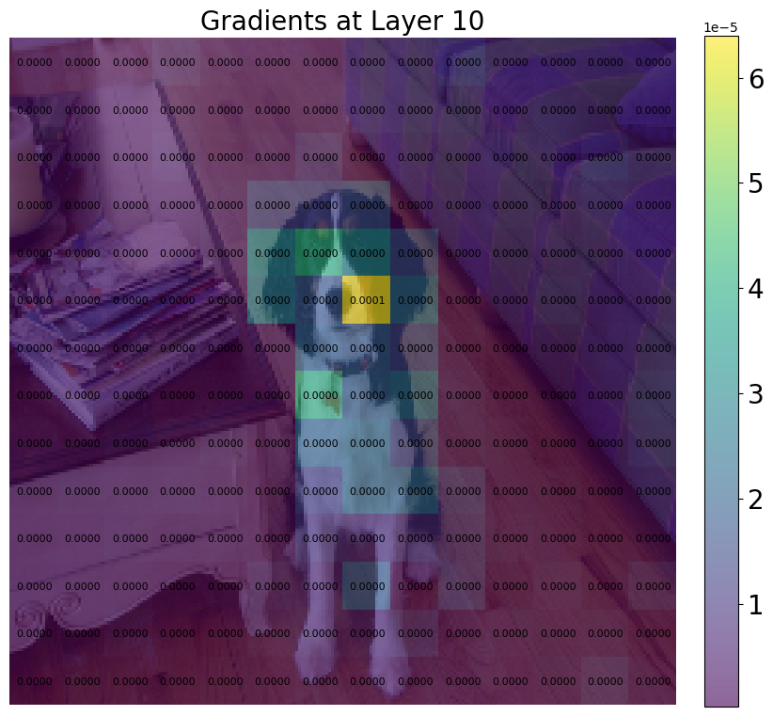
Concept Embedding
Gradient Relevance - Logits w.r.t. embedding at specific layer

Slide 17
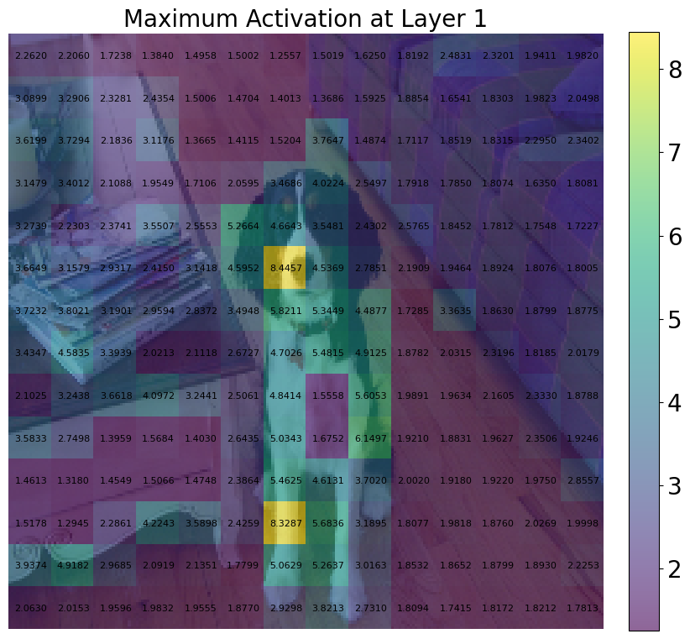
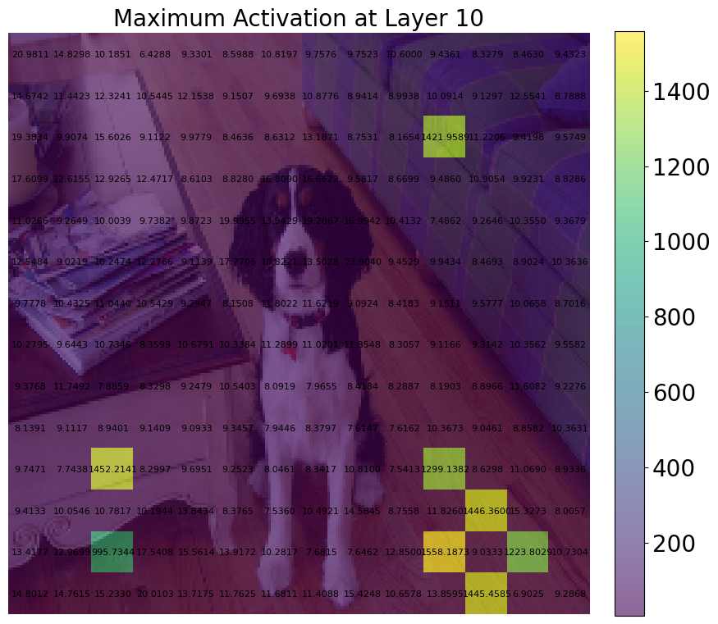
Concept Embedding
Embedding Relevance - Max. of 768 absolute values in embedding vector

Slide 18
Concept Embedding
relevance
embed
top-k &
average
average
14x14 = 196 Patches
196+1 (CLS) 768- Dimensional Embeddings
768-Dimensional Embeddings
Concept Embedding for Class “Dog”

Slide 19
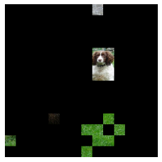
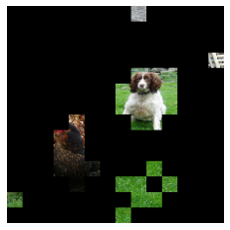
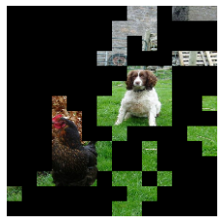
How Many Patches do we Select?
Motivation
Select as many patches as needed to capture the relevant pixel information concerning the concept
Select as little patches possible to not include unrelated information concerning the concept, e.g. background information.
Occlusion Experiment
Predict classes of all 20 images for 10 concepts → obtain top-k most relevant patches for different relevance approaches and k ∈ {1,2,4,8,16,32,64,128,196}
For each k → mask original images → insert into ViT for predictions → track accuracy
k=16
(rollout)
k=32
(rollout)
k=64
(rollout)

Slide 20
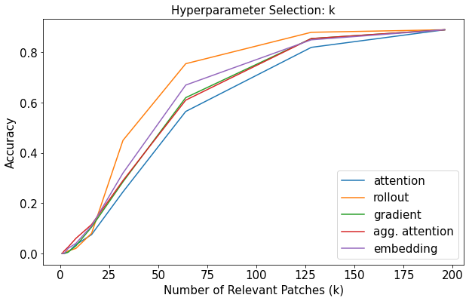
How Many Patches do we Select?
⇒ Select k = 50
Notes:
the more patches the higher the accuracy
steepness decreases
50 patches: high acc, no significant improvement of acc anymore

Slide 21
Experiments

Slide 22
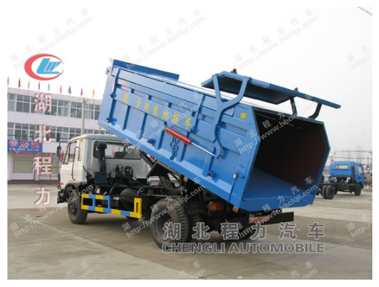
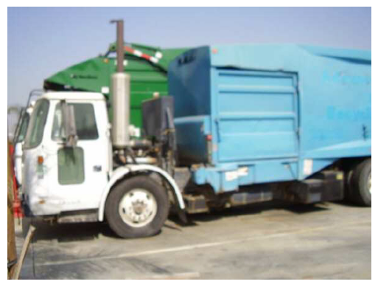


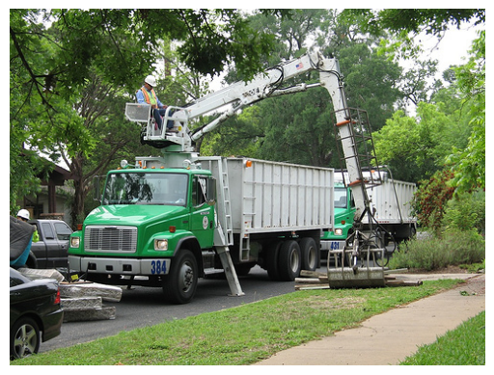
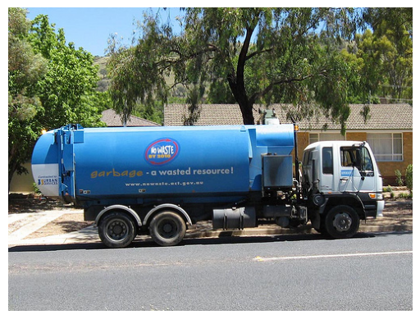

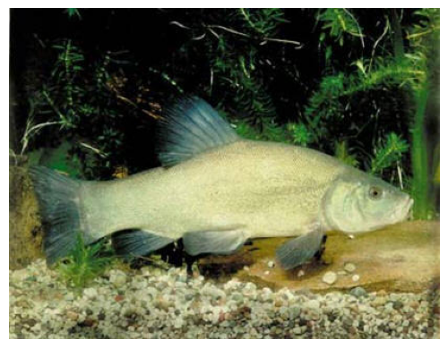
Concept Embedding
We have found average embeddings representing concepts
⇒ Can we use those to compare concepts? Do similar concepts share similar embeddings?
Concept “Dog”
Concept “Truck”
Concept “Fish”
Is distance(c(dog),c(fish)) < distance(c(dog),c(truck))? ⇒ What kind of metric can we use?

Slide 23
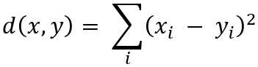
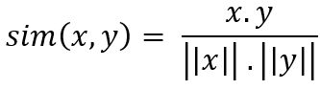
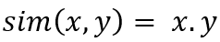
Experiments
Distance / Similarity
SSE
Cosine Similarity
Dot Product
where x, y are two 768-dimensional concept embeddings
Notes:
def embedding_distance(emb1, emb2, metric):
if metric == "sse":
dist = np.sum((emb1-emb2)**2)
elif metric == "cosine":
dist = np.dot(emb1,emb2)/(np.linalg.norm(emb1)*np.linalg.norm(emb2))
elif metric == "dot_product":
dist = np.dot(emb1,emb2)
else:
raise "Metric not supported"
return dist

Slide 24
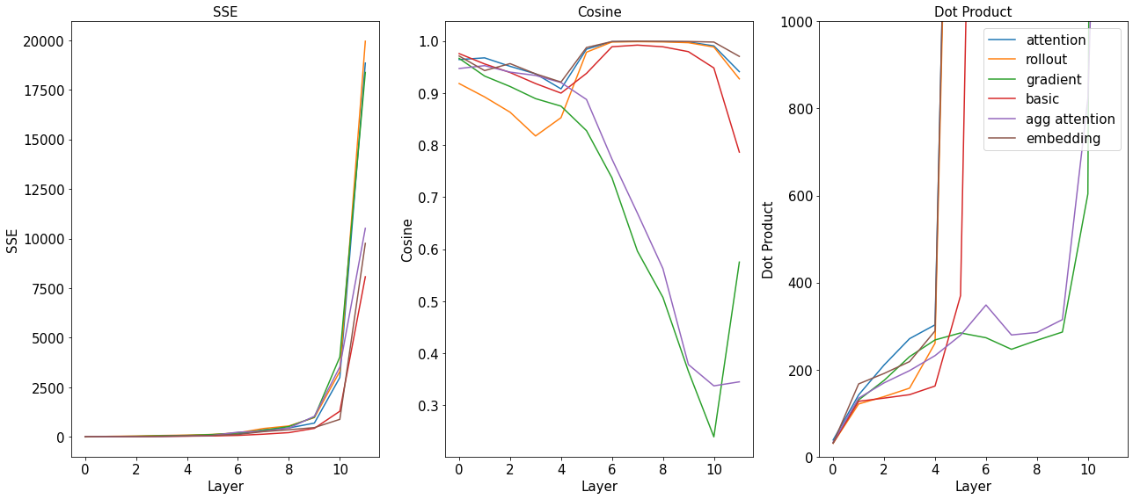
Experiments
Comparison of Concept Embeddings for “Dog” and “Fish”
(Y-Axis for Dot Product clipped to 1000)
Notes:
The higher the layer, the more different the concept embeddings seem to be. This is evident from the increasing SSE (distance) and the decreasing Cosine Similarity.
We can find patch selection approaches for each metric, which perform better in distinguishing the concepts than the basic approach.
=> Validity of results?

Slide 25
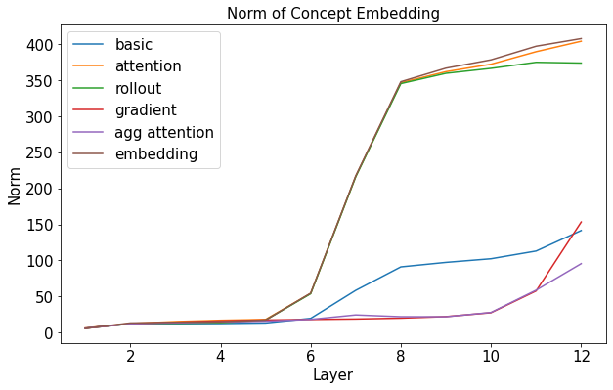
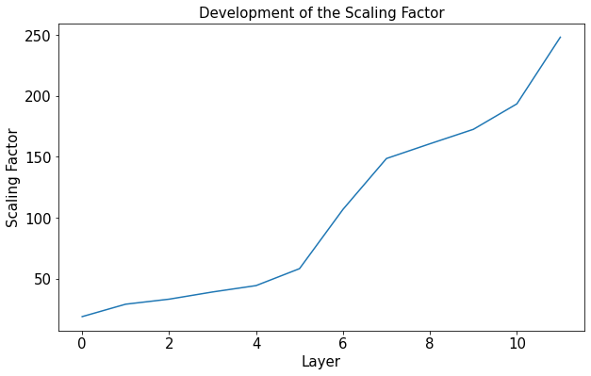
Experiments
Scaling of Distances
⇒ Scale calculated distances/similarities (not for Cosine): divide by squared scale
Notes:
Norm of concept embeddings
norm of patch embedding values increases with the layer
two groups: may be caused by the initial selection of relevant patches → trend is still there for both groups
Scaling factor
embedding values of all 20 examples per concept for each layer
norm of 768-dimensional values → avg over all patches, examples, and concepts
result: 12 scaling factors

Slide 26
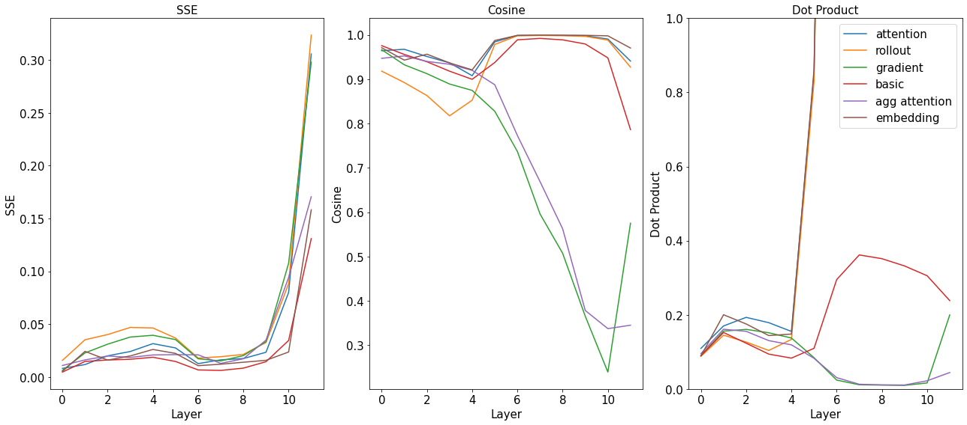
Experiments
Comparison of Concept Embeddings for “Dog” and “Fish” - Scaled
(Y-Axis for Dot Product clipped to 1)
Notes:
abs. values are smaller, trend remains
dot product: y-axis cropped to 1 for better resolution in lower values
scaling does not work for Dot Product

Slide 27
Experiments
Comparison of Concept Embeddings for “Dog” and “Fish” - Scaled
Increasing distinguishability of concept embeddings
Better distinguishability of concept embeddings of some patch selection methods

Slide 28
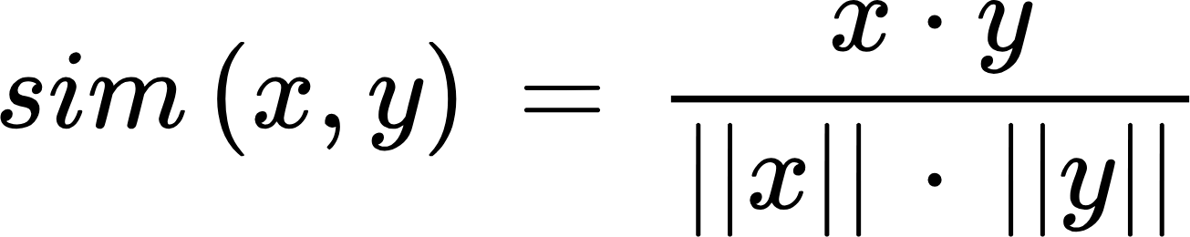
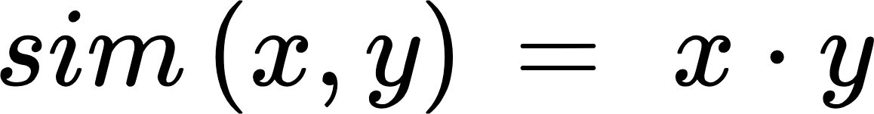
Experiments
Why is Using Dot Product not Working as Expected?
Scaling works for SSE but not for Dot Product
Only difference between Cosine & Dot Product: scaling → should behave similarly?
Cosine Similarity: Dot Product:
Scaling in cosine and our scaling factor only lead to comparable results, if there is not much variation in the norm of the vectors
BUT: ViTs use only a handful of embeddings to which they assign comparatively high values to store information (Darcet et al. 2024)
→ high variance in the norms of the embeddings → divergent behavior of Dot Product
⇒ Avoid using Dot Product in our further experiments

Slide 29
Experiments
What are the “best” combinations of metric and patch selection approach?
Two types of concept metrics are calculated:
between-concept metrics: for all combinations of concept pairs → calculate SSE & Cosine Similarity using concept embeddings → average over all layers
within-concept metrics: for each concept → for all combinations of image pairs → calculate SSE & Cosine Similarity using image embeddings → average over all layers
relevance
embed
top-k &
average
average
14x14 = 196 Patches
196+1 (CLS) 768- Dimensional Embeddings
768-Dimensional
Image Embeddings
Concept Embedding
for Class “Dog”
Notes:
metrics behavior depending on the patch relevance definition
blue: between-concept distances (avg. values across layers for all combinations of concept pairs)
green: within-concept distances (distance between all possible image pairs of a concept averaged over the layers, for all concepts)
Goal: distinguish between concepts → high SSE, low Cosine & Dot Product
within-concept should be smaller than between-concept → not the case
within-class: for original image pairs, between-class: between concept embeddings -> smaller scale due to avg
chosen data
Best combinations:
SSE & Attention Rollout
Cosine & gradient relevance

Slide 30
Experiments
What are the “best” combinations of metric and patch selection approach?
For better distinguishability between concepts:
SSE → high
Cosine Similarity → low
For better similarity within concepts:
SSE → low
Cosine Similarity → high
Notes:
metrics behavior depending on the patch relevance definition
blue: between-concept distances (avg. values across layers for all combinations of concept pairs)
green: within-concept distances (distance between all possible image pairs of a concept averaged over the layers, for all concepts)
Goal: distinguish between concepts → high SSE, low Cosine & Dot Product
within-concept should be smaller than between-concept → not the case
within-class: for original image pairs, between-class: between concept embeddings -> smaller scale due to avg
chosen data
Best combinations:
SSE & Attention Rollout
Cosine & gradient relevance

Slide 31
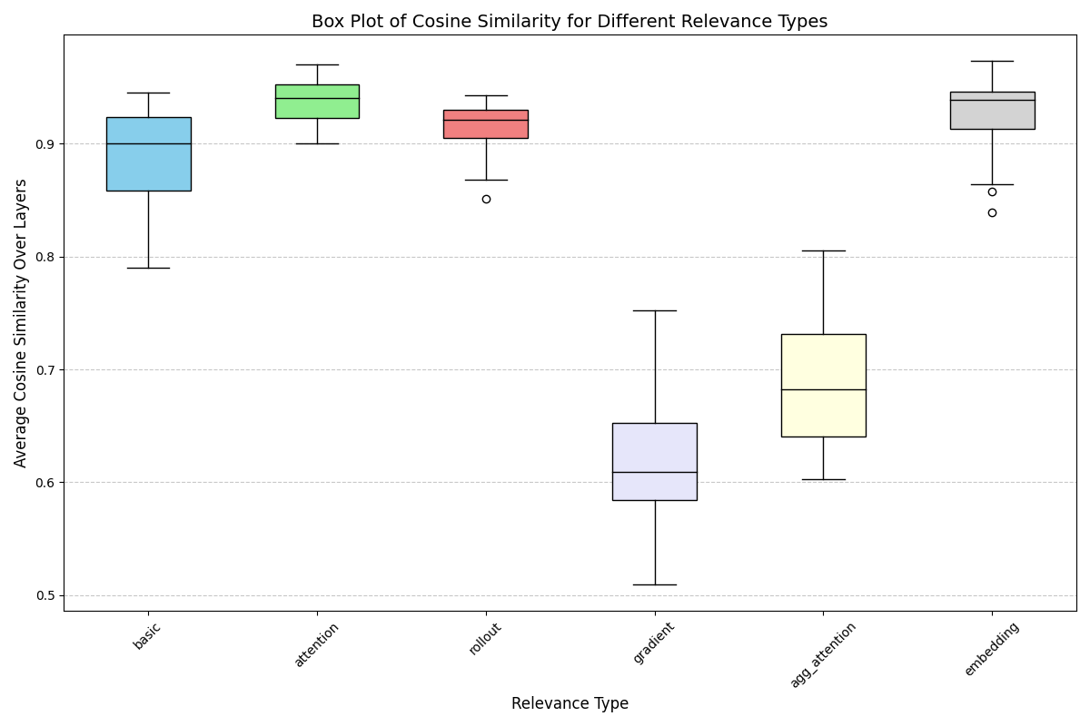
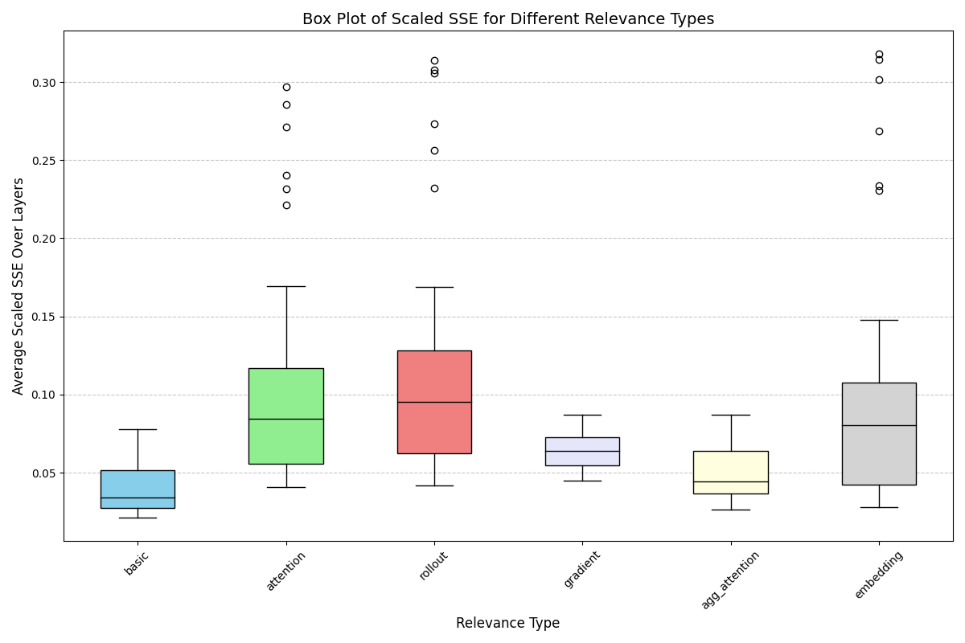
Experiments
Between-concept Box Plots
Notes:
metrics behavior depending on the patch relevance definition
blue: between-concept distances (avg. values across layers for all combinations of concept pairs)
green: within-concept distances (distance between all possible image pairs of a concept averaged over the layers, for all concepts)
Goal: distinguish between concepts → high SSE, low Cosine & Dot Product
within-concept should be smaller than between-concept → not the case
within-class: for original image pairs, between-class: between concept embeddings -> smaller scale due to avg
chosen data
Best combinations:
SSE & Attention Rollout
Cosine & gradient relevance

Slide 32
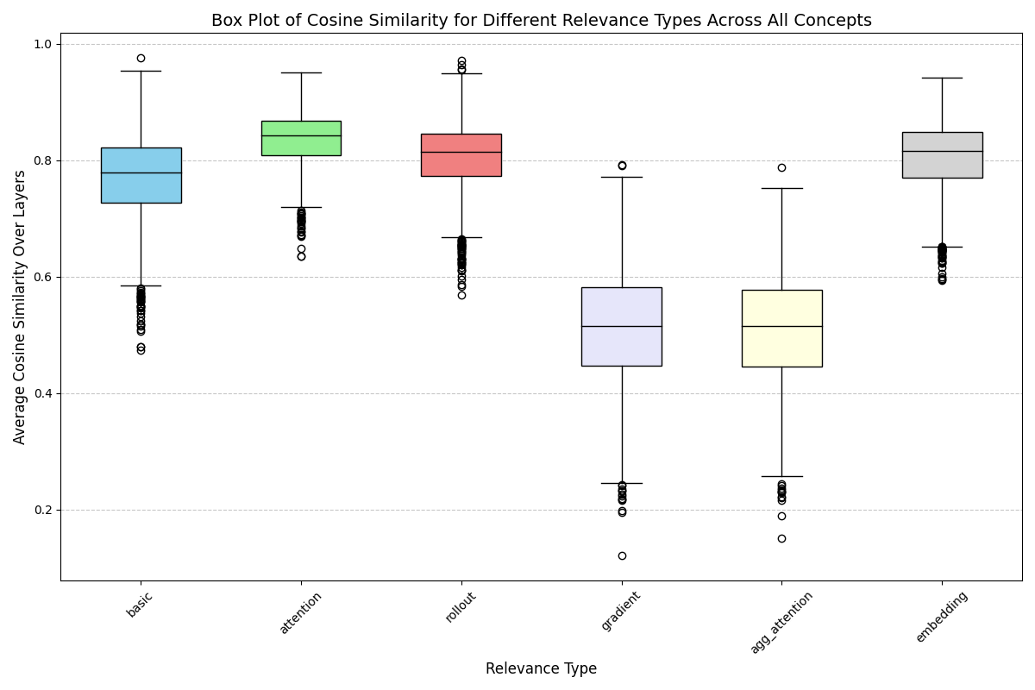
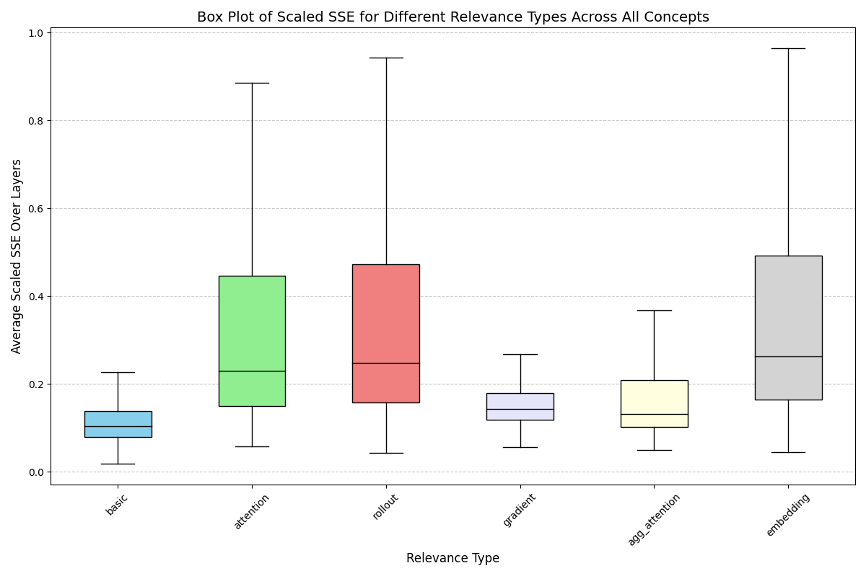
Experiments
Within-concept Box Plots for Concept ‘Dog’
Notes:
metrics behavior depending on the patch relevance definition
blue: between-concept distances (avg. values across layers for all combinations of concept pairs)
green: within-concept distances (distance between all possible image pairs of a concept averaged over the layers, for all concepts)
Goal: distinguish between concepts → high SSE, low Cosine & Dot Product
within-concept should be smaller than between-concept → not the case
within-class: for original image pairs, between-class: between concept embeddings -> smaller scale due to avg
chosen data
Best combinations:
SSE & Attention Rollout
Cosine & gradient relevance

Slide 33
Experiments
What are the “best” combinations of metric and patch selection approach?
For better distinguishability between concepts:
SSE → high
Cosine Similarity → low
For better similarity within concepts:
SSE → low
Cosine Similarity → high
Best Combinations | Metric | Patch Relevance
between-concept | SSE | Attention Rollout
 | Cosine Similarity | Gradient
within-concept | SSE | Gradient
 | Cosine Similarity | CLS Attention
Notes:
metrics behavior depending on the patch relevance definition
blue: between-concept distances (avg. values across layers for all combinations of concept pairs)
green: within-concept distances (distance between all possible image pairs of a concept averaged over the layers, for all concepts)
Goal: distinguish between concepts → high SSE, low Cosine & Dot Product
within-concept should be smaller than between-concept → not the case
within-class: for original image pairs, between-class: between concept embeddings -> smaller scale due to avg
chosen data
Best combinations:
SSE & Attention Rollout
Cosine & gradient relevance

Slide 34
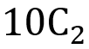
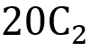
Experiments
Why are between-concept metrics smaller than within-concept metrics?
Method of calculating between-concept and within-concept metrics:
within-concept metrics → original image embeddings
between-concept metrics → concept embeddings → smaller scale due to averaging over all images of same concept
within-concept box plot has more number of metric values → wider IQR for box plot & more outliers
for each metric in [SSE, Cosine Similarity]: for each patch relevance method in ["basic", "attention", "rollout", "gradient", "agg_attention", "embedding"]:
number of metric values in between-concept box plot | number of metric values in within-concept box plot
= 45 → 10 concepts, taken as pairs | * 10 = 1900 → 20 images in each concept, taken as pairs * 10 concepts
Notes:
metrics behavior depending on the patch relevance definition
blue: between-concept distances (avg. values across layers for all combinations of concept pairs)
green: within-concept distances (distance between all possible image pairs of a concept averaged over the layers, for all concepts)
Goal: distinguish between concepts → high SSE, low Cosine & Dot Product
within-concept should be smaller than between-concept → not the case
within-class: for original image pairs, between-class: between concept embeddings -> smaller scale due to avg
chosen data
Best combinations:
SSE & Attention Rollout
Cosine & gradient relevance

Slide 35
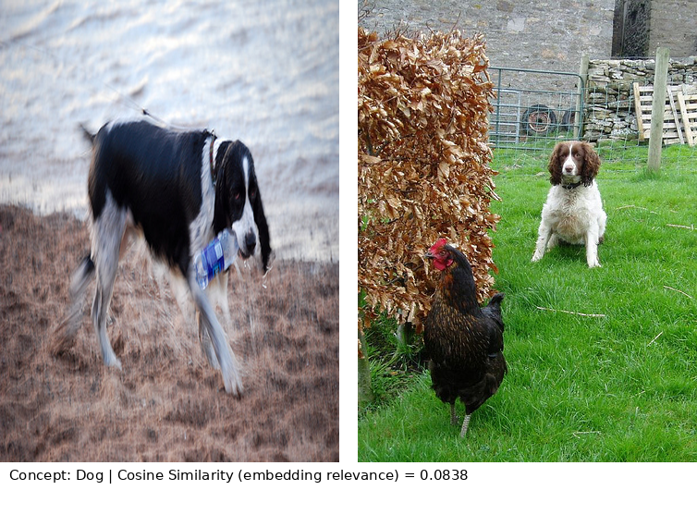
Experiments
Why are between-concept metrics smaller than within-concept metrics?
Chosen data:
for the creation of concepts, we used the first 20 images of the dataset that belong to the same class
some images contain unclear or partially covered concept object
eg: very dissimilar images within the same concept "Dog"
Notes:
metrics behavior depending on the patch relevance definition
blue: between-concept distances (avg. values across layers for all combinations of concept pairs)
green: within-concept distances (distance between all possible image pairs of a concept averaged over the layers, for all concepts)
Goal: distinguish between concepts → high SSE, low Cosine & Dot Product
within-concept should be smaller than between-concept → not the case
within-class: for original image pairs, between-class: between concept embeddings -> smaller scale due to avg
chosen data
Best combinations:
SSE & Attention Rollout
Cosine & gradient relevance

Slide 36
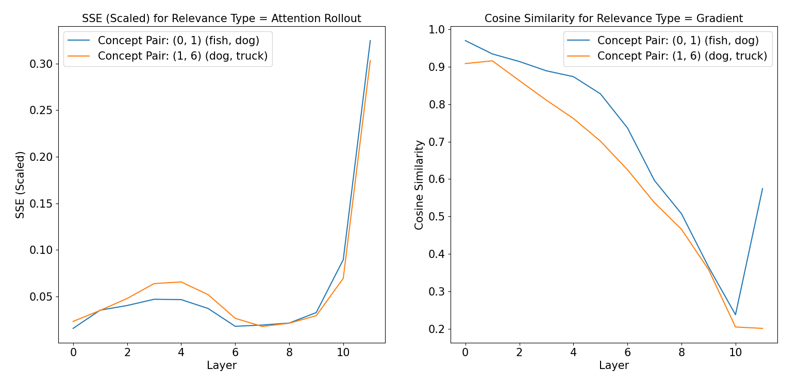
Experiments
Are the concept embeddings of "Dog" and "Fish" more similar than the concept embeddings of "Dog" and "Truck"?
⇒ ViT perceives concepts “Dog” and “Fish” as more similar than concepts “Dog” and “Truck”

Slide 37
Conclusion

Slide 38
Contributions
Investigation of how ViTs represent concepts and whether we can use these representations to distinguish between them in alignment with our human intuition
Introducing a novel idea of calculating concept embeddings with patch selection methods
Observed trends:
1. The higher the layer, the more different the concept embeddings seem to be
2. Patch selection approaches can better distinguish between concepts than an approach without patch selection
Analysis of between- & within-concept metrics to recommend best combination of metric and patch relevance
Concept embeddings could be used to find the nearest concept for a query concept
Validation of our approach by performing sanity checks

Slide 39
Limitations & Future Work
Limitations
Concept images not manually chosen
For better results, should have chosen better concepts to compare
eg. Dog and Cat vs Dog and Truck
Relatively small dataset
Only analyzed one pretrained ViT model
Future Work
Adjust calculation of between-concept metrics to similar approach of within-concept metrics
For each concept, manually select images that clearly show the concept object and retry the experiments
Investigate additional information sources to define patch relevance
Extend the experiments for larger datasets and more complex ViT models

Slide 40
References
Abnar, S., & Zuidema, W. (2020). Quantifying Attention Flow in Transformers (arXiv:2005.00928). arXiv. http://arxiv.org/abs/2005.00928
Bach, S., Binder, A., Montavon, G., Klauschen, F., Müller, K.-R., & Samek, W. (2015). On Pixel-Wise Explanations for Non-Linear Classifier Decisions by Layer-Wise Relevance Propagation. PLOS ONE, 10(7), e0130140. https://doi.org/10.1371/journal.pone.0130140
Darcet, T., Oquab, M., Mairal, J., & Bojanowski, P. (2024). Vision Transformers Need Registers (arXiv:2309.16588). arXiv. http://arxiv.org/abs/2309.16588
Dosovitskiy, A., Beyer, L., Kolesnikov, A., Weissenborn, D., Zhai, X., Unterthiner, T., Dehghani, M., Minderer, M., Heigold, G., Gelly, S., Uszkoreit, J., & Houlsby, N. (2021). An Image is Worth 16x16 Words: Transformers for Image Recognition at Scale (arXiv:2010.11929). arXiv. http://arxiv.org/abs/2010.11929
Dwivedi, R., Dave, D., Naik, H., Singhal, S., Omer, R., Patel, P., Qian, B., Wen, Z., Shah, T., Morgan, G., & Ranjan, R. (2023). Explainable AI (XAI): Core Ideas, Techniques, and Solutions. ACM Computing Surveys, 55(9), 1–33. https://doi.org/10.1145/3561048
Kim, B., Wattenberg, M., Gilmer, J., Cai, C., Wexler, J., Viegas, F., & Sayres, R. (2018). Interpretability Beyond Feature Attribution: Quantitative Testing with Concept Activation Vectors (TCAV) (arXiv:1711.11279). arXiv. http://arxiv.org/abs/1711.11279

Slide 41
References
Kashefi, R., Barekatain, L., Sabokrou, M., & Aghaeipoor, F. (2023). Explainability of Vision Transformers: A Comprehensive Review and New Perspectives (arXiv:2311.06786). arXiv. http://arxiv.org/abs/2311.06786
Selvaraju, R. R., Cogswell, M., Das, A., Vedantam, R., Parikh, D., & Batra, D. (2020). Grad-CAM: Visual Explanations from Deep Networks via Gradient-based Localization. International Journal of Computer Vision, 128(2), 336–359. https://doi.org/10.1007/s11263-019-01228-7
Shams Khoozani, Z., Sabri, A. Q. M., Seng, W. C., Seera, M., & Eg, K. Y. (2024). Navigating the landscape of concept-supported XAI: Challenges, innovations, and future directions. Multimedia Tools and Applications, 83(25), 67147–67197. https://doi.org/10.1007/s11042-023-17666-y
Sundararajan, M., Taly, A., & Yan, Q. (2016). Gradients of Counterfactuals (arXiv:1611.02639). arXiv. http://arxiv.org/abs/1611.02639
Vaswani, A., Shazeer, N., Parmar, N., Uszkoreit, J., Jones, L., Gomez, A. N., Kaiser, L., & Polosukhin, I. (2023). Attention Is All You Need (arXiv:1706.03762). arXiv. http://arxiv.org/abs/1706.03762

Slide 42
Thank You!

Slide 43
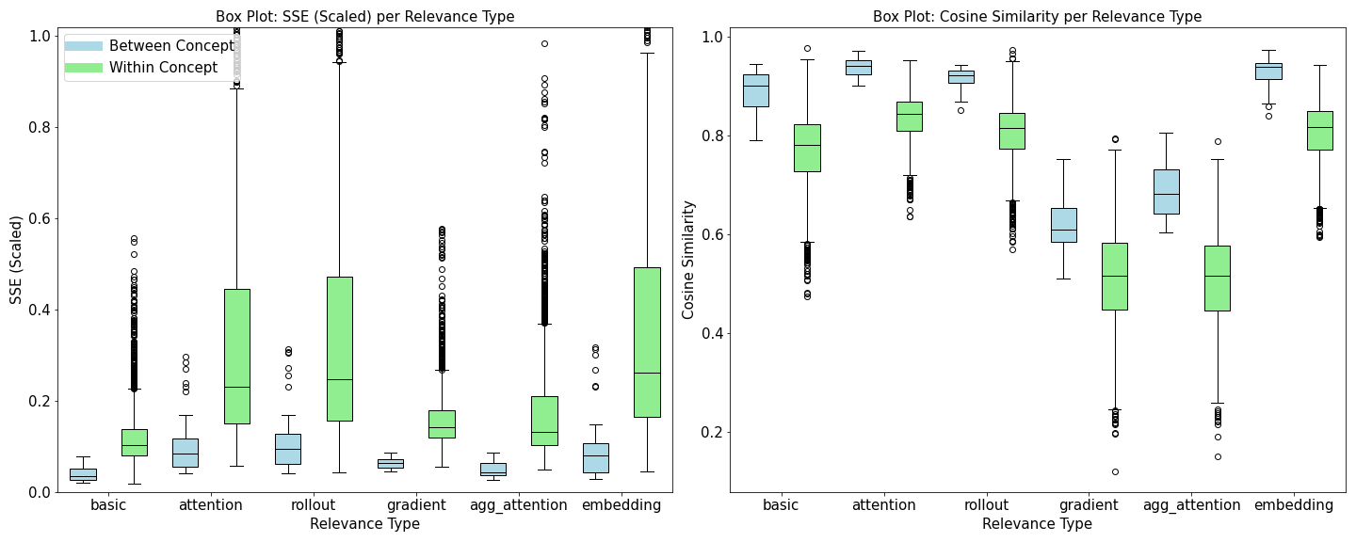
Experiments
What are the “best” combinations of metric and patch selection approach?
Notes:
metrics behavior depending on the patch relevance definition
blue: between-concept distances (avg. values across layers for all combinations of concept pairs)
green: within-concept distances (distance between all possible image pairs of a concept averaged over the layers, for all concepts)
Goal: distinguish between concepts → high SSE, low Cosine & Dot Product
within-concept should be smaller than between-concept → not the case
within-class: for original image pairs, between-class: between concept embeddings -> smaller scale due to avg
chosen data
Best combinations:
SSE & Attention Rollout
Cosine & gradient relevance

Slide 44
Experiments
What are the “best” combinations of metric and patch selection approach?
Two types of concept metrics are calculated:
between-concept metrics: for all combinations of concept pairs → calculate SSE & Cosine Similarity using concept embeddings → average over all layers
within-concept metrics: for each concept → for all combinations of image pairs → calculate SSE & Cosine Similarity using image embeddings → average over all layers
relevance
embed
top-k &
average
average
14x14 = 196 Patches
196+1 (CLS) 768- Dimensional Embeddings
768-Dimensional
Image Embeddings
Concept Embedding
for Class “Dog”
Notes:
metrics behavior depending on the patch relevance definition
blue: between-concept distances (avg. values across layers for all combinations of concept pairs)
green: within-concept distances (distance between all possible image pairs of a concept averaged over the layers, for all concepts)
Goal: distinguish between concepts → high SSE, low Cosine & Dot Product
within-concept should be smaller than between-concept → not the case
within-class: for original image pairs, between-class: between concept embeddings -> smaller scale due to avg
chosen data
Best combinations:
SSE & Attention Rollout
Cosine & gradient relevance

Slide 45
Experiments
What are the “best” combinations of metric and patch selection approach?
Notes:
metrics behavior depending on the patch relevance definition
blue: between-concept distances (avg. values across layers for all combinations of concept pairs)
green: within-concept distances (distance between all possible image pairs of a concept averaged over the layers, for all concepts)
Goal: distinguish between concepts → high SSE, low Cosine & Dot Product
within-concept should be smaller than between-concept → not the case
within-class: for original image pairs, between-class: between concept embeddings -> smaller scale due to avg
chosen data
Best combinations:
SSE & Attention Rollout
Cosine & gradient relevance

Slide 46
Experiments
Why are between-concept metrics smaller than within-concept metrics?
Method of calculating between-concept and within-concept metrics:
within-concept metrics → original image embeddings
between-concept metrics → concept embeddings → smaller scale due to averaging over all images of same concept
within-concept box plot has more number of metric values → wider IQR for box plot & more outliers
for each metric in [SSE, Cosine Similarity]: for each patch relevance method in ["basic", "attention", "rollout", "gradient", "agg_attention", "embedding"]:
number of metric values in between-concept box plot | number of metric values in within-concept box plot
= 45 → 10 concepts, taken as pairs | * 10 = 1900 → 20 images in each concept, taken as pairs * 10 concepts
Notes:
metrics behavior depending on the patch relevance definition
blue: between-concept distances (avg. values across layers for all combinations of concept pairs)
green: within-concept distances (distance between all possible image pairs of a concept averaged over the layers, for all concepts)
Goal: distinguish between concepts → high SSE, low Cosine & Dot Product
within-concept should be smaller than between-concept → not the case
within-class: for original image pairs, between-class: between concept embeddings -> smaller scale due to avg
chosen data
Best combinations:
SSE & Attention Rollout
Cosine & gradient relevance

Slide 47
Experiments
Why are between-concept metrics smaller than within-concept metrics?
Chosen data:
for the creation of concepts, we used the first 20 images of the dataset that belong to the same class
some images contain unclear or partially covered concept object
eg: very dissimilar images within the same concept "Dog"
Notes:
metrics behavior depending on the patch relevance definition
blue: between-concept distances (avg. values across layers for all combinations of concept pairs)
green: within-concept distances (distance between all possible image pairs of a concept averaged over the layers, for all concepts)
Goal: distinguish between concepts → high SSE, low Cosine & Dot Product
within-concept should be smaller than between-concept → not the case
within-class: for original image pairs, between-class: between concept embeddings -> smaller scale due to avg
chosen data
Best combinations:
SSE & Attention Rollout
Cosine & gradient relevance

Slide 48
Agenda
Introduction & Motivation
Methodology
Experiments
Conclusions
References

Slide 49
Concept Embedding
Attention Relevance - CLS Attention

Slide 50
Concept Embedding
Attention Relevance - Attention Rollout (Abnar & Zuidema 2020)

Slide 51
Concept Embedding
Attention Relevance - Aggregated Attention (layer-wise max. attention over all heads)

Slide 52
Concept Embedding
Gradient Relevance - Logits w.r.t. embedding at specific layer

Slide 53
Concept Embedding
Embedding Relevance - Max. of 768 absolute values in embedding vector

Slide 54
Motivation
XAI methods: local and global explanations (Dwivedi et al. 2023)
global: overall analysis of the model and its general behavior

Slide 55
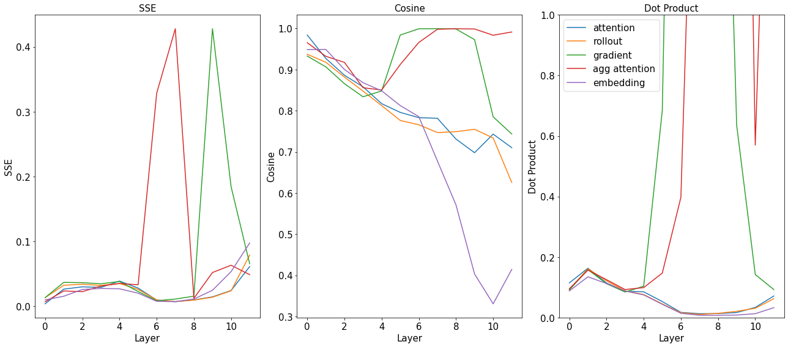
Sanity Check - Flipped Selection
Notes:
Only in case there are some questions, do not show in the first place

Slide 56
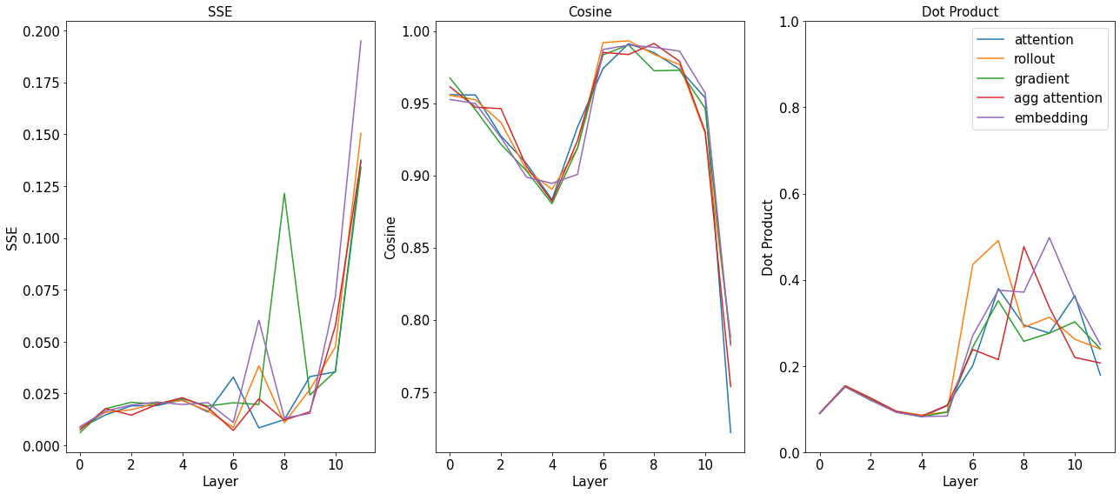
Sanity Check - Random Selection
Notes:
Only in case there are some questions, do not show in the first place

Slide 57
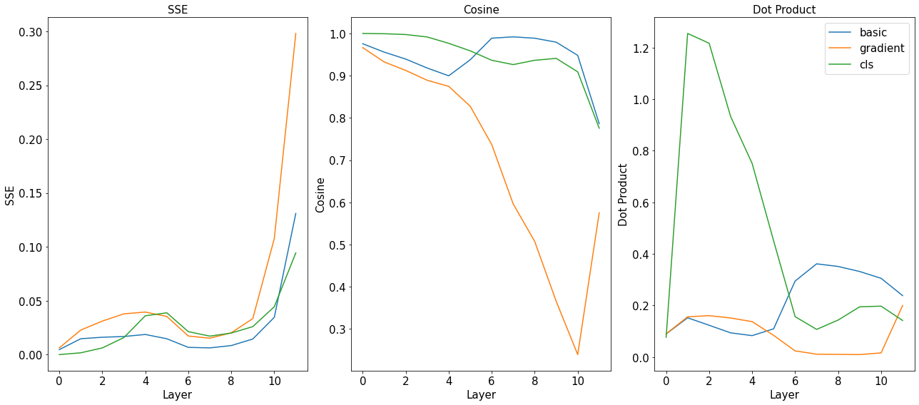
Sanity Check - CLS Token
Notes:
Only in case there are some questions, do not show in the first place

Slide 58
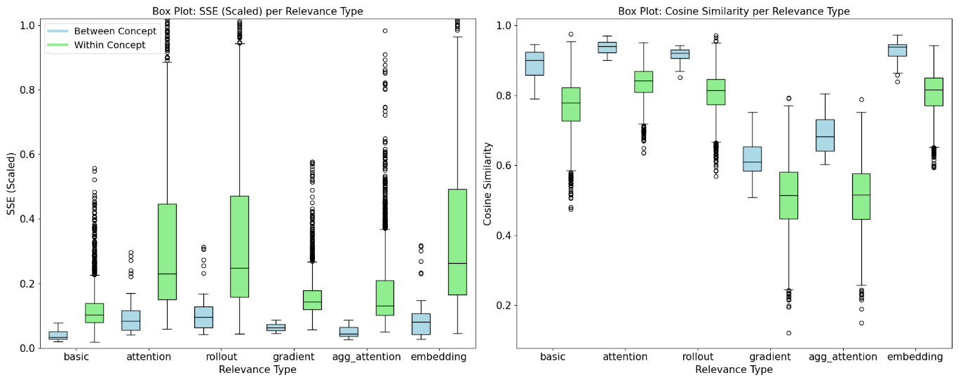
Experiments
What are the “best” combinations of metric and patch selection approach?
Notes:
metrics behavior depending on the patch relevance definition
blue: between-concept distances (avg. values across layers for all combinations of concept pairs)
green: within-concept distances (distance between all possible image pairs of a concept averaged over the layers, for all concepts)
Goal: distinguish between concepts → high SSE, low Cosine & Dot Product
within-concept should be smaller than between-concept → not the case
within-class: for original image pairs, between-class: between concept embeddings -> smaller scale due to avg
chosen data
Best combinations:
SSE & Attention Rollout
Cosine & gradient relevance

Slide 59

Most Similar Concept Pairs
Notes:
Only in case there are some questions, do not show in the first place

Slide 60
Experiments
Why are between-concept distances smaller than within-concept distances?
Example of Very Dissimilar Images Within the Same Concept "Dog"
Notes:
metrics behavior depending on the patch relevance definition
blue: between-concept distances (avg. values across layers for all combinations of concept pairs)
green: within-concept distances (distance between all possible image pairs of a concept averaged over the layers, for all concepts)
Goal: distinguish between concepts → high SSE, low Cosine & Dot Product
within-concept should be smaller than between-concept → not the case
within-class: for original image pairs, between-class: between concept embeddings -> smaller scale due to avg
chosen data
Best combinations:
SSE & Attention Rollout
Cosine & gradient relevance

